Slide 1

Disseminating methodological work to statisticians and researchers using a tweetorial
Emily Granger
Email: emily.granger@lshtm.ac.uk
Github: https://github.com/EmilyG602
Twitter: @EGranger90

Slide 2
What is a #tweetorial?

Slide 3
What is a #tweetorial?
A tutorial that is made by stringing together a series of tweets, with the aim of educating your followers on a particular topic

Slide 4
Why do a #tweetorial?
A tutorial that is made by stringing together a series of tweets, with the aim of educating your followers on a particular topic

Slide 5

Why do a #tweetorial?
Why do a #tweetorial?
A tutorial that is made by stringing together a series of tweets, with the aim of educating your followers on a particular topic
Promote your own research
Improve knowledge

Slide 6
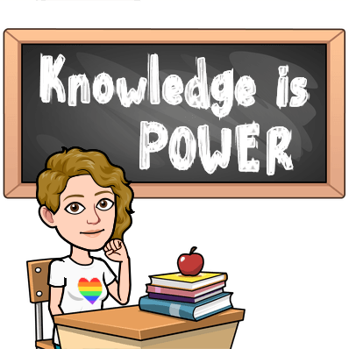
Why do a #tweetorial?
A tutorial that is made by stringing together a series of tweets, with the aim of educating your followers on a particular topic
Promote your own research
Improve knowledge

Slide 7
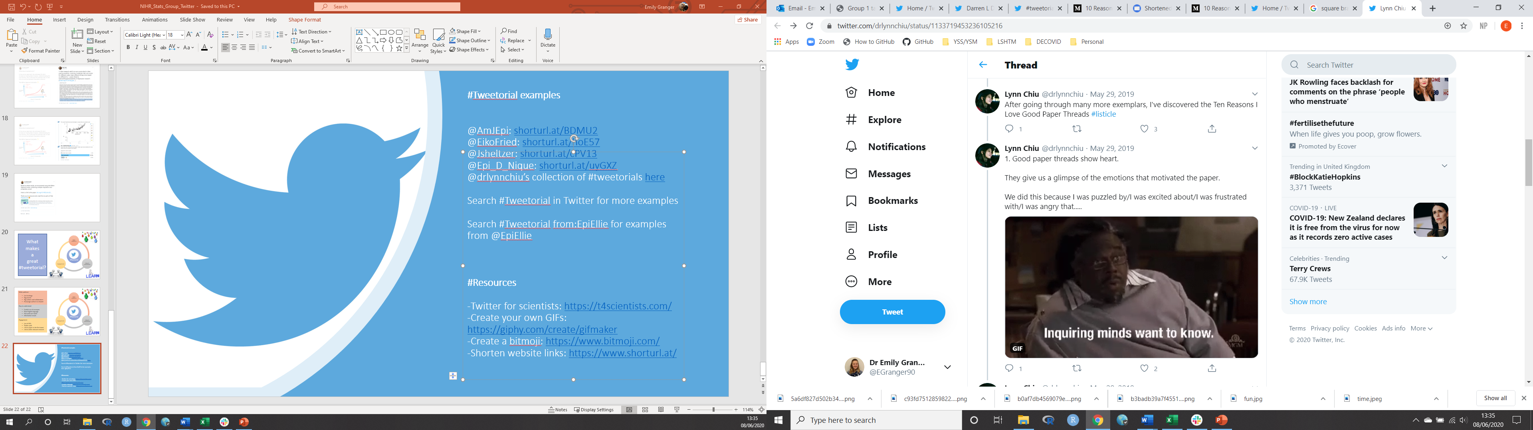
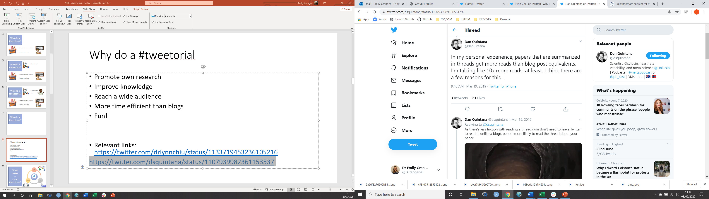
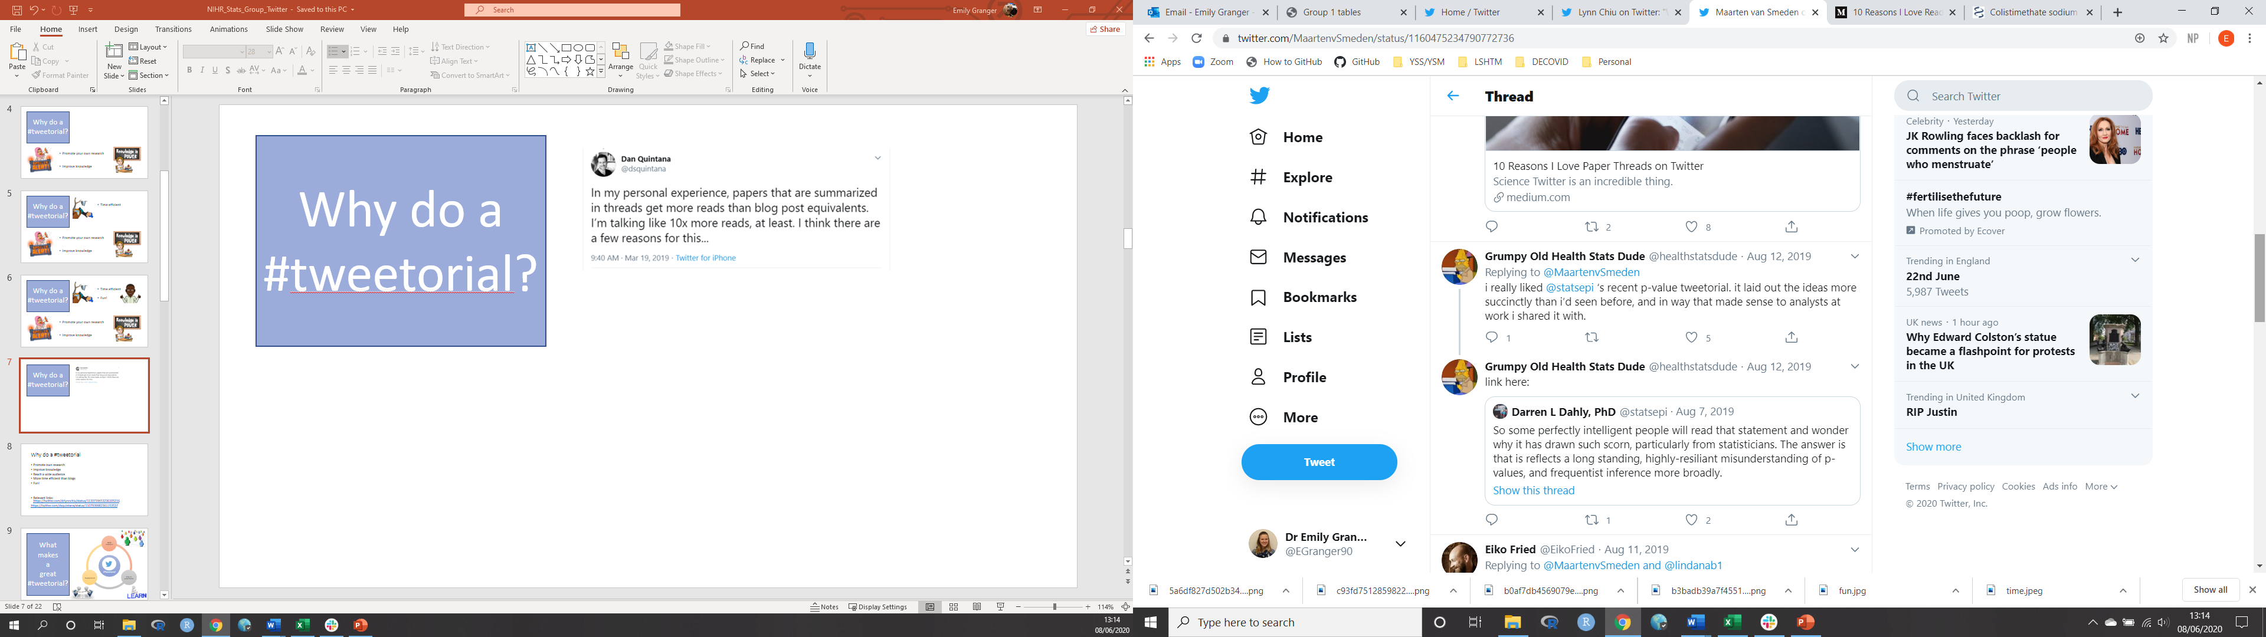
Why do a #tweetorial?
Relevant Links
“Why I love [#tweetorials]” by @drlynnchiu : here
A blog post on “10 Reasons I Love Reading Paper Threads on Twitter”: here
“You should used a Twitter thread to announce new appears instead of a blog post. Here’s why…” by @dsquintana : here
@statsepi #tweetorial on p-values: here

Slide 8

What
makes
a
great
#tweetorial?
#Tweetorial
Reach a wide audience
Easy to understand
Encourage engagement

Slide 9
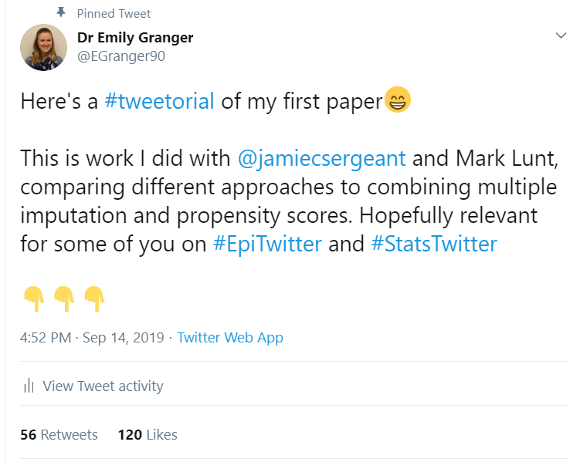

Slide 10

Use hashtags to reach a wider audience
#MedTwitter
#AcademicTwitter
#AcademicChatter
#PhDChat

Slide 11
Use hashtags to reach a wider audience
#MedTwitter
#AcademicTwitter
#AcademicChatter
#PhDChat
Tag relevant people and organisations
Tag relevant people and organisations:
Co-authors and collaborators
Research centres
Funders
Journal
Encourage retweets!

Slide 12
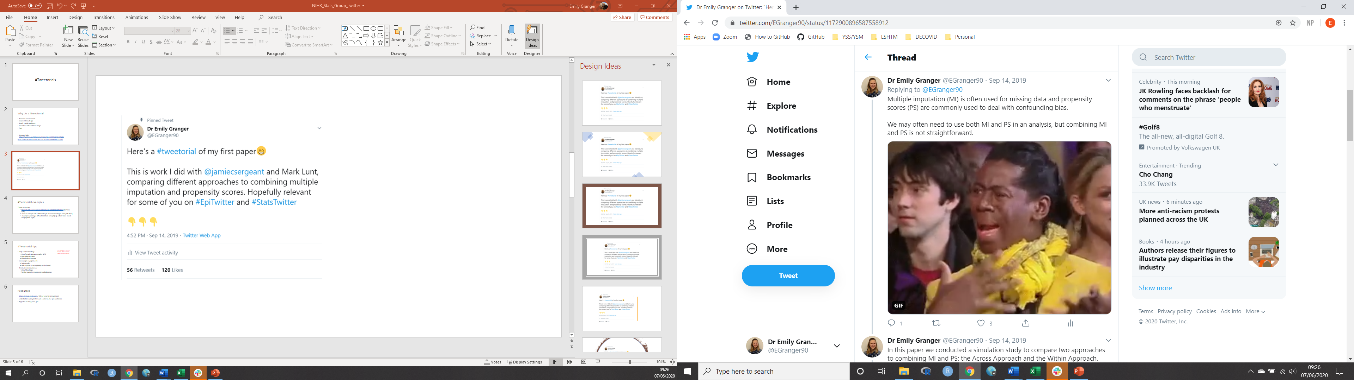
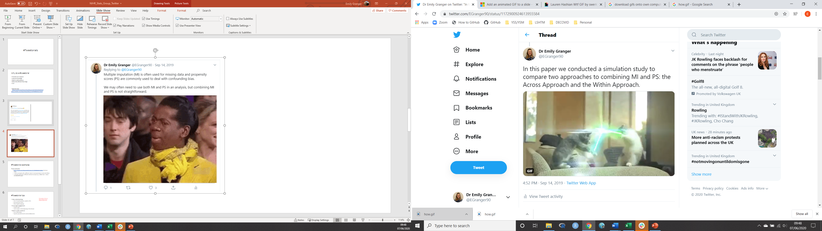

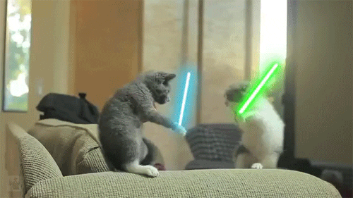

Slide 13
I’ve since learnt about digital blackface; please be mindful of this when using gifs

Slide 14
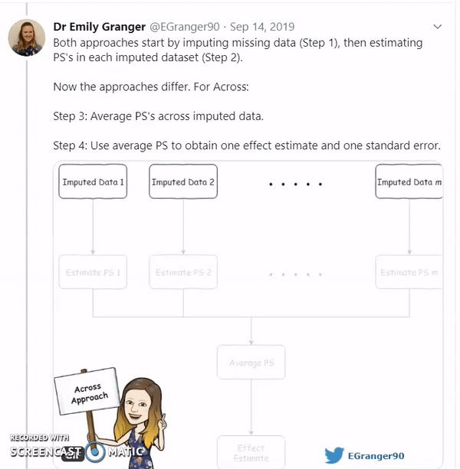
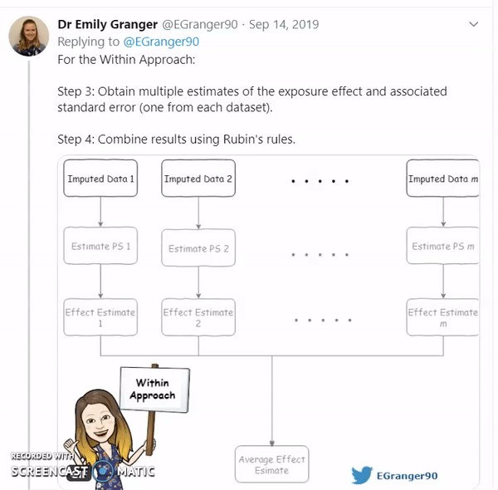

Slide 15
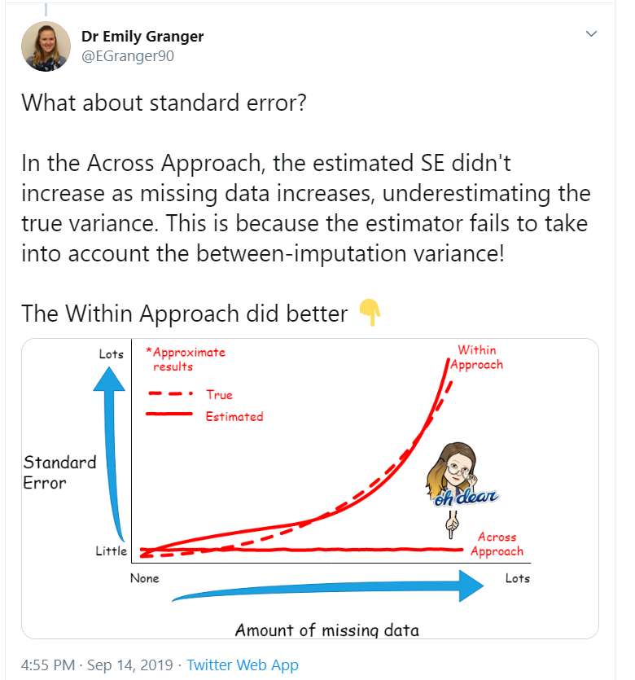

Slide 16
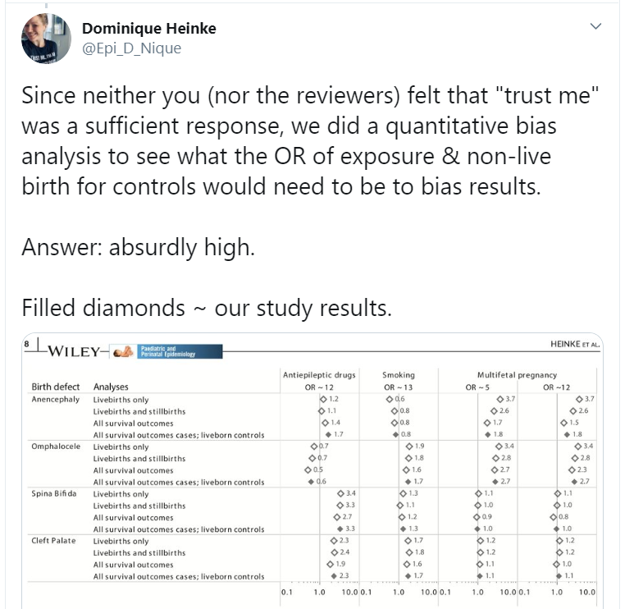

Slide 17
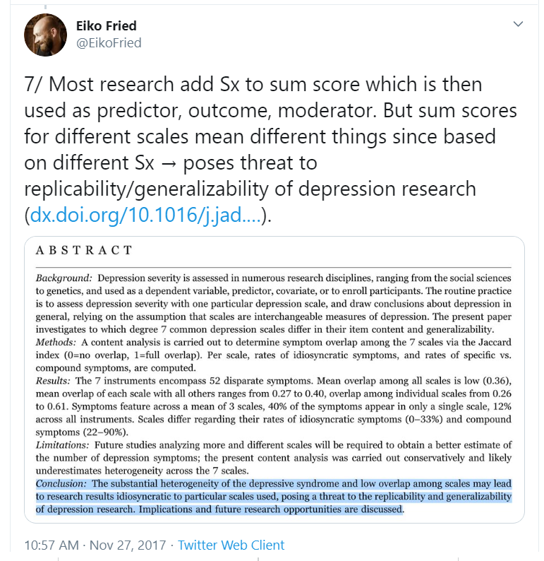

Slide 18
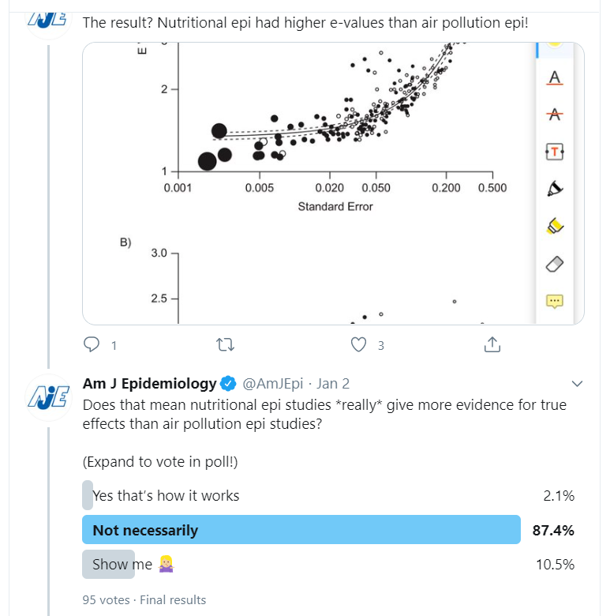

Slide 19
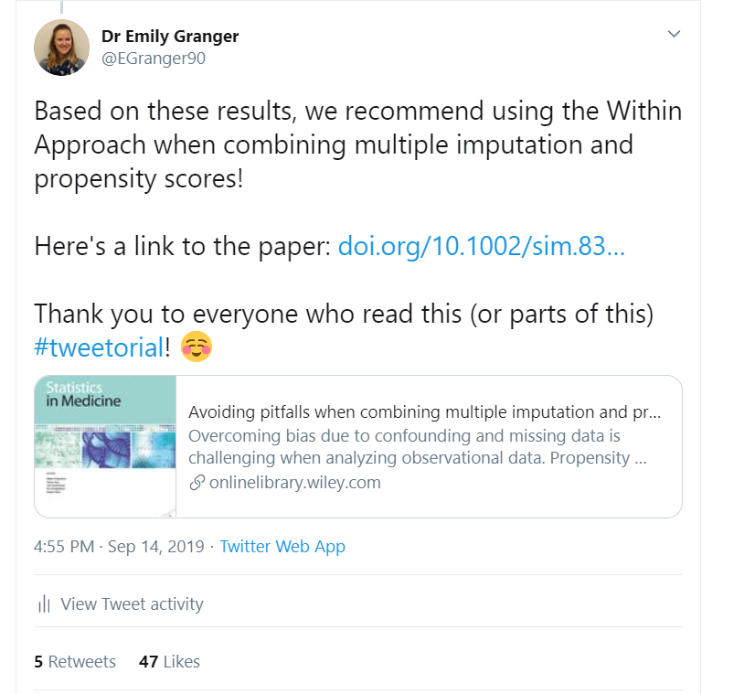

Include link to your paper
Better to do this in the first tweet!
Can shorten weblinks to save space
Thank your readers and those who helped you with the research

Slide 20
What
makes
a
great
#tweetorial?
#Tweetorial
Reach a wide audience
Easy to understand
Encourage engagement

Slide 21
Wide audience:
Use hashtags
Tag authors and collaborators
Tag funders and journal
Encourage authors to retweet
#Tweetorial
Reach a wide audience
Easy to understand
Encourage engagement
Easy to understand:
Plain language
Define your acronyms
One point per tweet
Informative visuals
Engagement:
Use of GIFs
Twitter polls
Link to other relevant research
Link to paper in the first tweet

Slide 22
#Tweetorial examples @Jsheltzer:survival analysis @EikoFried:clinical psychology @AmJEpi: e-values @Epi_D_Nique: collider bias @drlynnchiu’s collection of #tweetorials here Search #Tweetorial in Twitter for more examples #Resources -Twitter for scientists: https://t4scientists.com/ -Create your own GIFs: https://giphy.com/create/gifmaker -Create a bitmoji: https://www.bitmoji.com/ -Shorten website links: https://www.shorturl.at/

